Slide 1
ES-SES4000 Facility Mangement Project
Southeast University College of Norway
NovoFM team:
Badis Madani (Project Manager)
Håkon Hedlund (System Engineer)
Zhili Shao
Arshad Shakil
Supervisor :
Prof. Aurilla Arntzen

Slide 2
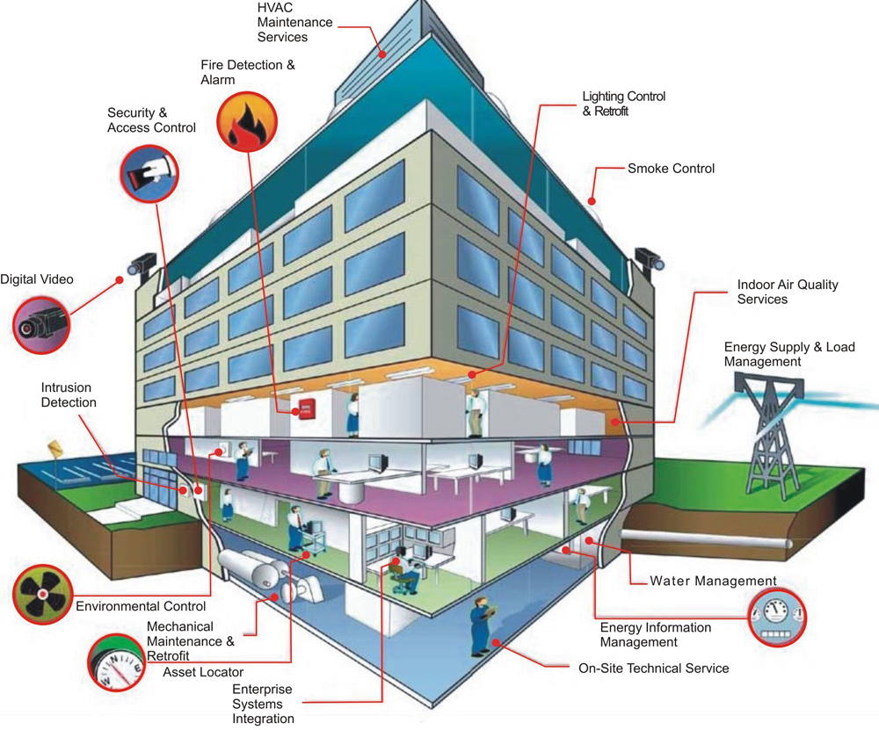
Facility Management
FM is the integration of processes within an organization to maintain and develop the agreed services which support and improve the effectiveness of its primary activities.

Slide 3
Facilities:
Schools
Office buildings
Hotels
Hospitals
Apartment complexes
Shopping centers,
Restaurants
Parking lots
Airports
Bus & Train stations
Services:
Lighting service
Fire security
HVAC (Heating, ventilation, air conditioning)
Access control (to the facility)
Energy monitoring
CCTV,..etc.

Slide 4
Opportunity (Case study)
FM is a very complex domain.
HVAC (Heating, ventilation, air conditioning)
Indoor environment (Temperature, Humidity, Air quality)
The Goal:
Design a smart control system for HVAC services in facilities, by making it more efficient and easier to use, by 1st May 2016.

Slide 5
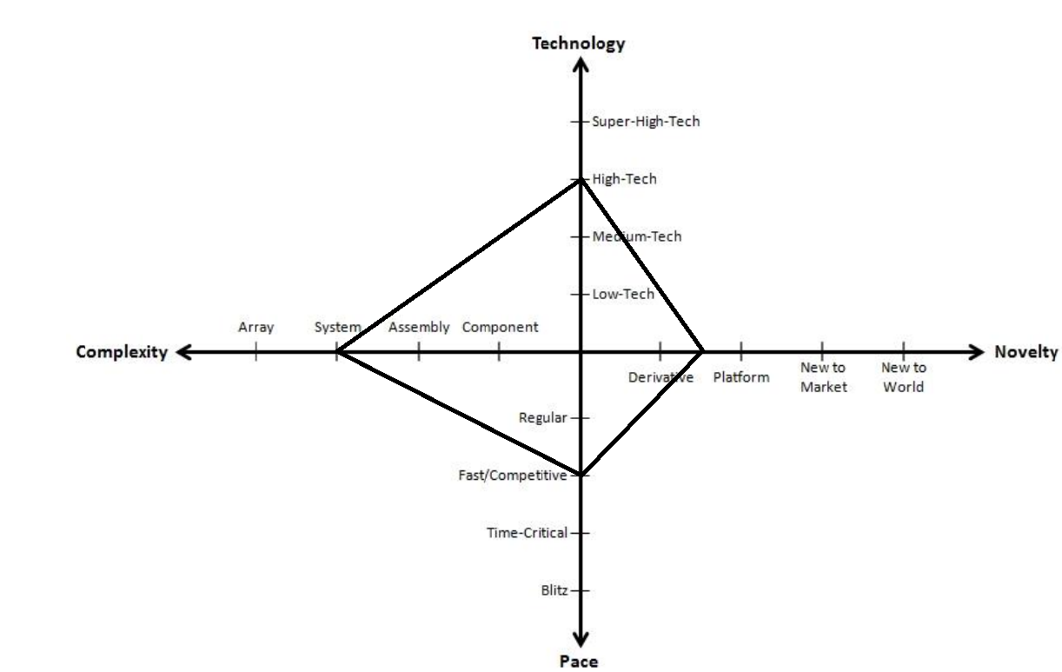
Project Taxonomy

Slide 6
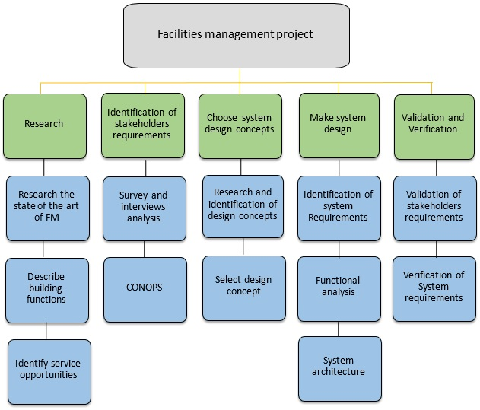
WBS

Slide 7
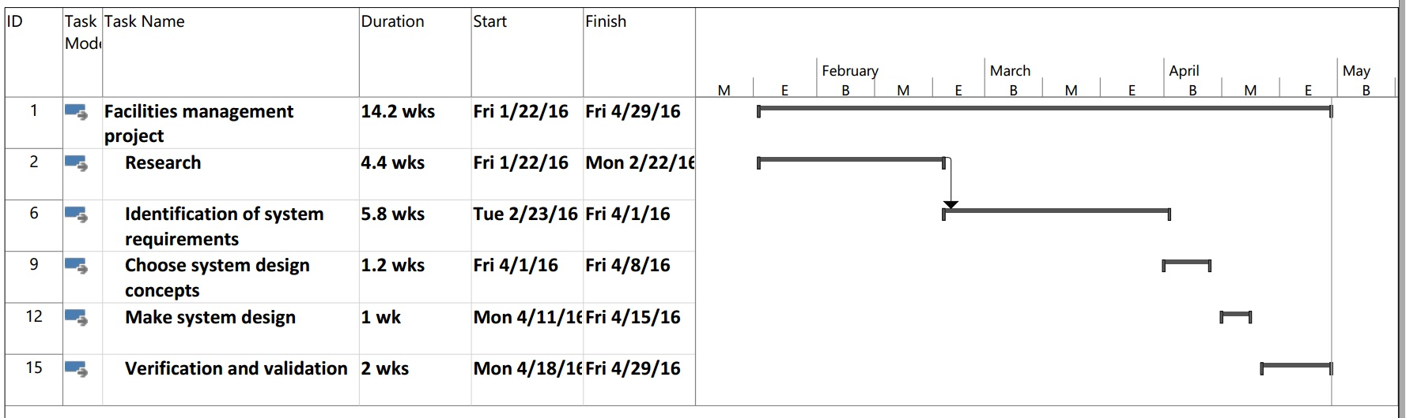
Gantt Chart

Slide 8
Risk management
Type | Source | Level | Strategy | Solution
Project Risk | Lack of competence | Medium | Reduction | Do internal training and devote more human hours on research. External training.
 | Project delay | High | Prevention | Project leader follows up on the group’s work. And the group has knowledge about the project delay. Set More hours.
Task Risk | Not compatible with current system | High | Prevention | Verify current systems and its standards
Business Risk | Solution is similar to something on the market | Medium | Prevention | Keeping track of current trends and systems on the market
Conflict Risk | Disagreement over project issues | Medium | Reduction | Collaborating, Compromising, Smoothing, Forcing, and Withdrawing

Slide 9
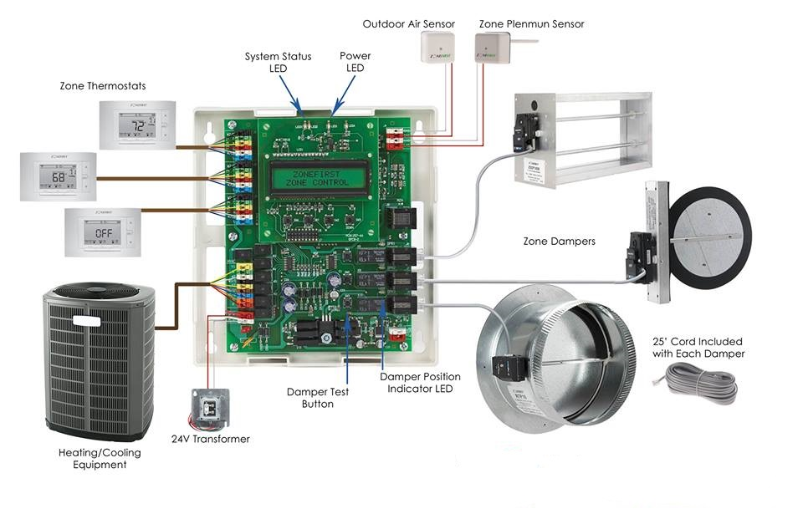
Current HVAC control system

Slide 10
Stakeholders
Defined five stakeholders
Users
Facility manager
HVAC vendor
Estate owner
Government

Slide 11
Survey analysis
Questionnaires and online survey were used
63 people questioned, 15 were employees and the rest students
They were asked questions about age, occupation, how satisfied they were about indoor environment, what they would want to change if they had the chance, and how they want to change it.

Slide 12
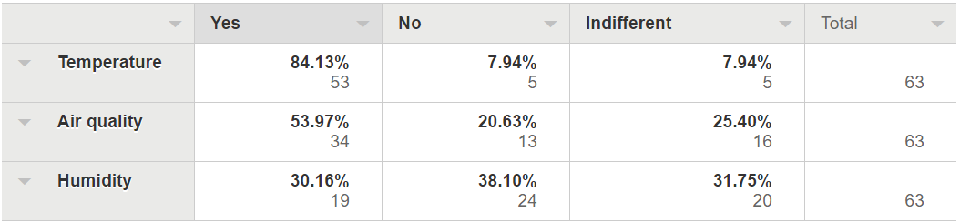
Would you like to be able to regulate?

Slide 13
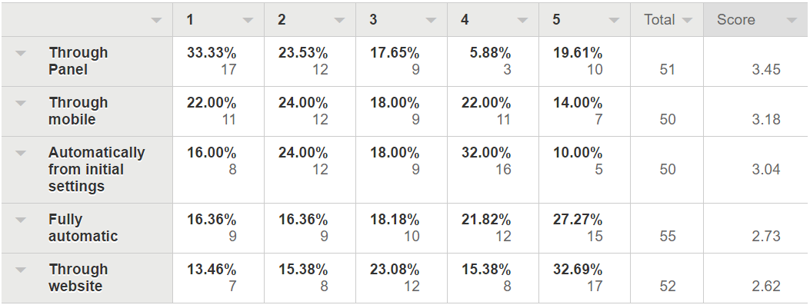
What solution do you prefer?

Slide 14
User requirements
Being able to track the temperature, humidity, indoor air quality (CO2 level)
Being able to change the temperature as they like accordingly as well as the humidity, and indoor air quality
Ease of use
Accessibility

Slide 15
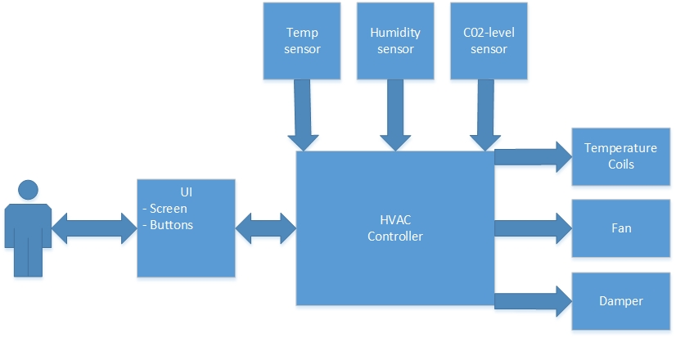
CONOPS

Slide 16
Design alternatives
Proposed three design concepts
Panel controller
Remote controller
Mobile app controller
Selection criteria
Initial cost
Life-cycle cost
Easiness of use
Easiness of installing

Slide 17
AHP matrix
 | Initial cost | Life-cycle cost | Easiness of use | Easiness of installing | Weighted Evaluation
Criteria Weights | 0,0799 | 0,3000 | 0,5488 | 0,0714
Design Concepts
Panel Control | 0,2114 | 0,2390 | 0,6070 | 0,1429 | 0,4319
App Control | 0,6864 | 0,6234 | 0,0897 | 0,7143 | 0,3420
Remote Control | 0,1022 | 0,1376 | 0,3033 | 0,1429 | 0,2261

Slide 18

Selection of preferred design
Survey analysis -> Panel control
Pugh matrix -> Panel control
AHP matrix -> Panel control
Preferred design concept -> Panel solution

Slide 19
System requirement
Stakeholder Requirement | System Requirement | COTS | Classification
Monitor and adjust temperature | Collect temperature data for display and computation | Temperature Sensor, Microcontroller | Must have
Monitor humidity | Collect humidity data for display and computation | Humidity Sensor, Microcontroller | Must have
Monitor and adjust CO2-level | Collect CO2-level data for display and computation | CO2 Sensor, Microcontroller | Must have
Ease of use, Accessibility | Provide UI to interact with user | Touchscreen, Microcontroller | Must have
Ease of use | UI reaction logic, Communication with sensors, Data calculation, HVAC control signal output. | Microcontroller | Must have
Adjust indoor environment, Compatibility with existing HVAC system, Ease of deployment | Connect to HVAC controller | 4-Channel Relay Module | Must have

Slide 20
System requirement
Stakeholder Requirement | System Requirement | COTS | Classification
Adjust humidity | Increase air humidity | Humidifier | Nice to have
Ease of use | Change the configuration of indoor temperature according to time. | Microcontroller | Nice to have
Energy saving, Ease of use | Automatically switch to economy mode | Motion Sensor | Nice to have
Ease of use | Collect weather information from internet | WIFI module, Weather forecast website | Desirable
Accessibility, Ease of use | To tell information and setting about HVAC system using voice for blind people or people in dark room. | WIFI module, Voice interaction server | Desirable
Cost of implementation | Give user access to get information and setting HVAC system by website. | WIFI module, Website | Desirable
Ease of use | Give user access to get information and setting HVAC system by mobile phone. | WIFI module, Apps | Desirable

Slide 21
Functional analysis

Slide 22
Function Block Diagram

Slide 23
Function Block Diagram

Slide 24
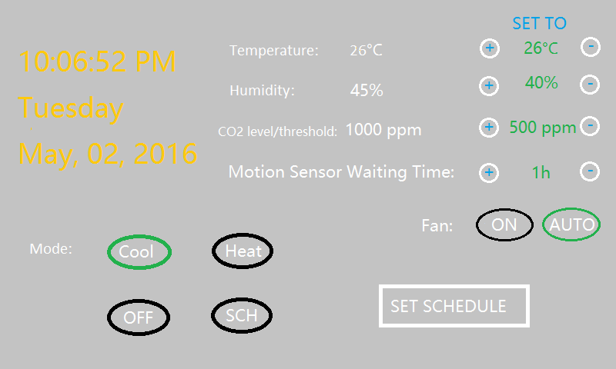
User Interface

Slide 25
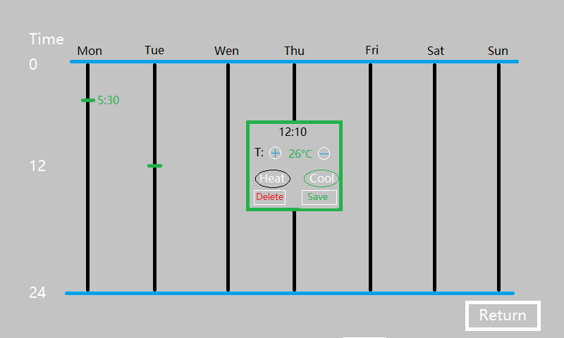
User Interface

Slide 26
Hardware Components

Slide 27
HW block diagram

Slide 28
Bill of materials (BoM)
ITEM | Description | Price US $
1. ARM STM32F103 MCU | Microcontroller | 3
2. ER-TFT070-4 TFT LCD | 7 inch TFT LCD touchscreen | 30
3. 4-Channel Relay | 5V 1-Channel Relay Module | 5
4. 1-Channel Relay | 5V 4-Channel Relay Module | 9
5.DHT11 sensor | Temperature and humidity sensor | 5
6. DS18B20 sensor | Temperature sensor | 10
7.MH-14 sensor | NDIR Infrared CO2 sensor | 79
8.HC-SR501 sensor | PIR motion sensor | 3

Slide 29
Summary
Researched FM and its facilities
Focused on HVAC
Did a survey and gathered requirements for potential stakeholders
Picked a design solution based on calculations -> control panel
Generated systems requirements
Did a functional analysis and made a functional block diagram
Found components for the solution
Made hardware block diagram
Made an UI for the panel

Slide 30
References
“Cloud-Based Approach for Smart Facilities Management” D. Laut, J. Liu, S. Majumdar, B. Nandy, M. St-Hilaire, and C.S. Yang.
“Prométhée, a Collaborative tool for a more effective Facility management process” SDPS 2015.
“Systems Engineering, Theory and Practice” book. Alberto Sols.
Blanchard, Benjamin S. c2008. System engineering management. Hoboken, NJ.
ES-4000 Systems Engineering slides.
http://www.idef.com/
http://www.umsl.edu/~sauterv/analysis/488_f01_papers/Ohlendorf.htm
http://www.cppasiapacific.com/overview/TKI-11
http://www.personalityexplorer.com/freeresources/conflictmanagementtechniques.aspx
http://www.bsdsolutions.com/about-us/bsd-news/2012/04/3-reasons-to-use-direct-digital-control-systems-in-hvac/
http://www.personalityexplorer.com/freeresources/conflictmanagementtechniques.aspx

Slide 31
Prototype Display …

